Slide 2
Top 10 Azure Security Best Practices
Mark Simos
Lead Cybersecurity Architect

Slide 3
Attack services are cheap
More details at https://aka.ms/CISOWorkshop
Exploit kits:
Price: $1,400 per month
Highest average price
Zero-days:
Price: $5,000 to $350,000
Ransomware:
Price: $66 upfront or
30% of the profit (affiliate model)
Loads (compromised device):
Price: PC - $0.13 to $0.89
Mobile - $0.82 to $2.78
Attackers
Spearphishing services:
Price: $100 to $1,000 per successful account take over
Compromised accounts:
Price: $150 for 400M Averages $0.97 per 1,000
Breaching services on a per job basis:
Price range: $250 or much more
Denial of Service:
Price: $766.67 per month

Slide 4
Attack services are cheap
More details at https://aka.ms/CISOWorkshop
Zero-days:
Price: $5,000 to $350,000
Exploit kits:
Price: $1,400 per month
FOCUS ON HYGIENE (NOT ZERO DAYS)
Zero day vulnerabilities are expensive and impractical for many attacks. https://aka.ms/CyberHygiene has guidance from Microsoft + NIST, the Center for Internet Security (CIS), and US DHS NCCIC (formerly US-CERT)
Ransomware:
Price: $66 upfront or
30% of the profit (affiliate model)
Loads (compromised device):
Price: PC - $0.13 to $0.89
Mobile - $0.82 to $2.78
Spearphishing services:
Price: $100 to $1,000 per successful account take over
FOCUS ON MFA/PASSWORDLESS & ZERO TRUST
Attackers have moved to Identity attacks like phishing and cred theft (which easily evade traditional network defenses)
Increase cost of these attacks starting with administrative privileges and other business critical assets
Attackers
Compromised accounts:
Price: $150 for 400M Averages $0.97 per 1,000
Denial of Service:
Price: $766.67 per month
Breaching services on a per job basis:
Price range: $250 or much more
ENABLE DDoS PROTECTION FOR CRITICAL SERVICES
Ensure that your business-critical services have DDoS protection from Azure platform or a capable 3rd parties

Slide 5

Agenda
Introduction:
Azure Security Compass
Secure Score
Top 10 Best practices
Calls to Action
Follow Best Practices
Learn More
Share
Provide Feedback

Slide 6
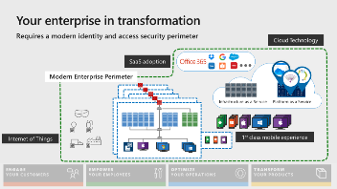
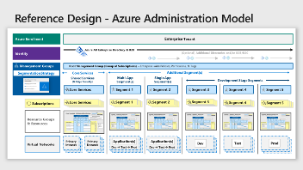
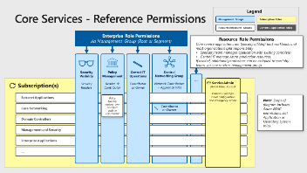
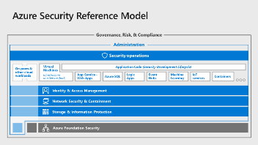
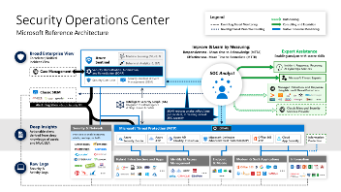
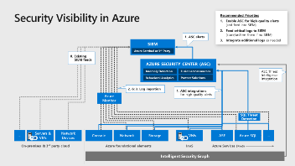
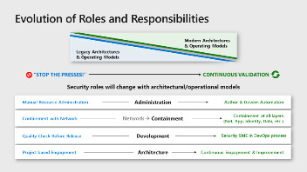
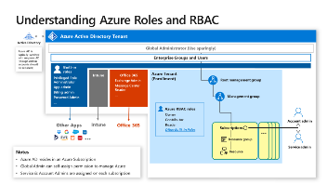
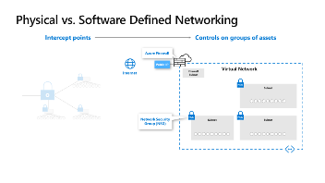
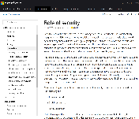
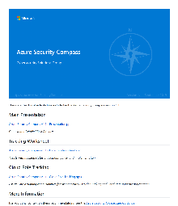
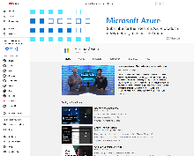
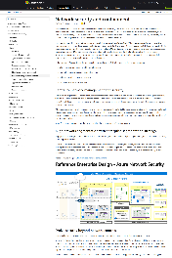
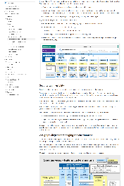
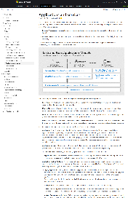
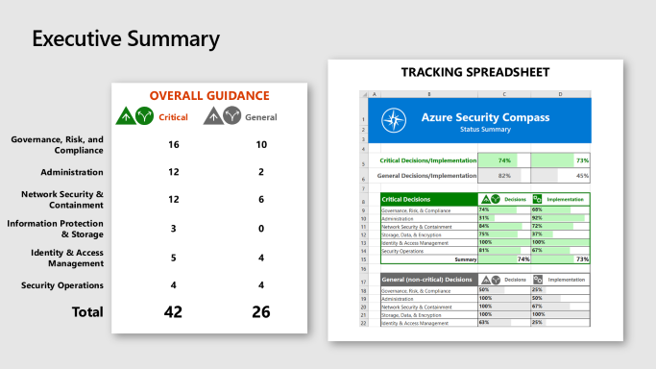
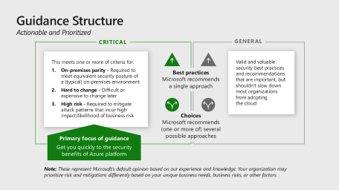
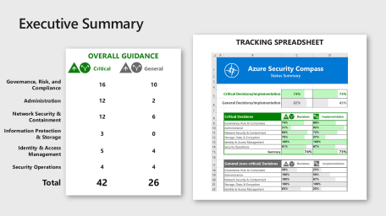
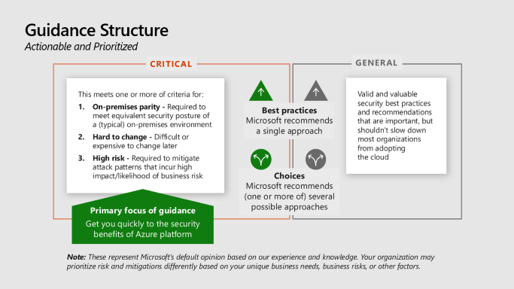
What is Azure Security compass?
Azure Security Guidance
Strategy Transformation Guidance
Changes from On-premises Security
Reference Models / Diagrams
Actionable Best Practices (Top 10 is a subset)
Extensive Visualizations
Architecture Documentation aka.ms/AzureSecurityArchitecture
Download Site aka.ms/AzureSecurityCompass
Slides –
Tracking Spreadsheets
And more…
Videos aka.ms/AzureSecurityCompass-Videos
COMING SOON

Slide 7

Guidance Structure Actionable and Prioritized
Critical
General
This meets one or more of criteria for:
On-premises parity - Required to meet equivalent security posture of a (typical) on-premises environment
Hard to change - Difficult or expensive to change later
High risk - Required to mitigate attack patterns that incur high impact/likelihood of business risk
Valid and valuable security best practices and recommendations that are important, but shouldn’t slow down most organizations from adopting the cloud
Best practices
Microsoft recommends a single approach
Choices
Microsoft recommends (one or more of) several possible approaches
Primary focus of guidance
Get you quickly to the security benefits of Azure platform
Note: These represent Microsoft’s default opinion based on our experience and knowledge. Your organization may prioritize risk and mitigations differently based on your unique business needs, business risks, or other factors.

Slide 8
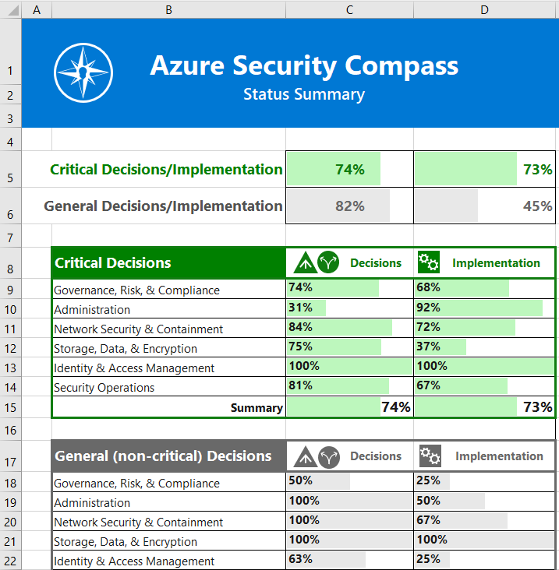
Executive Summary
Tracking Spreadsheet
Overall Guidance
 |  | Critical | General
Governance, Risk, and Compliance |  | 16 | 10
Administration |  | 12 | 2
Network Security & Containment |  | 12 | 6
Information Protection & Storage |  | 3 | 0
Identity & Access Management |  | 5 | 4
Security Operations |  | 4 | 4
Total |  | 42 | 26

Slide 9

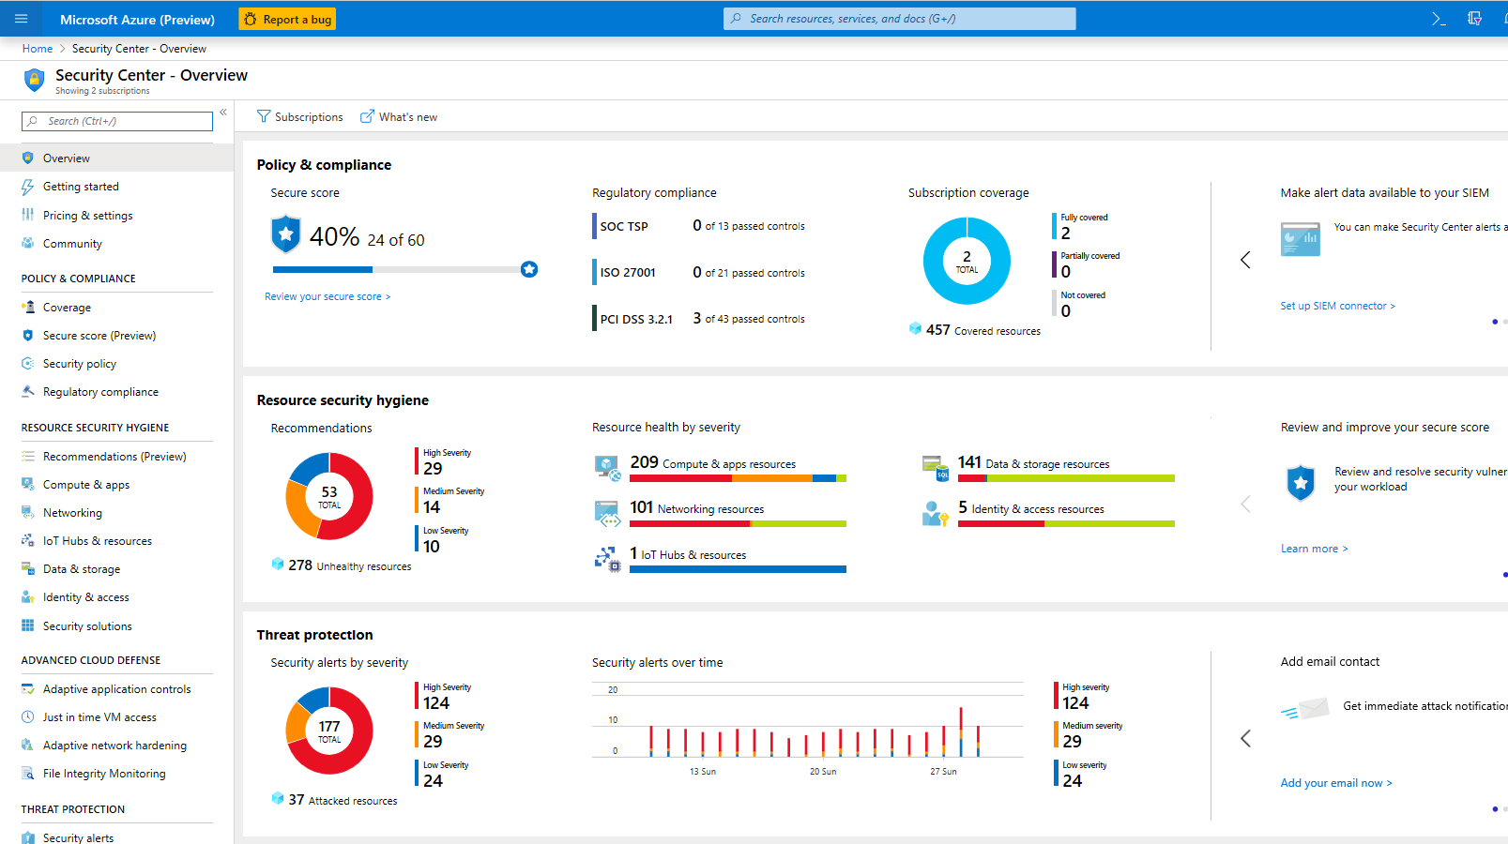
Visibility Across Your Estate with Secure Score
NEW (Private Preview) – Percentage based reporting for easier tracking/benchmarking
NEW (Private Preview) – Recommendation Grouping for Clarity (attack vectors/security controls)

Slide 10
Top 10 Best Practices
Focused on Highest Impact and Rapid Implementation

Slide 11
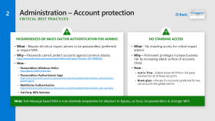
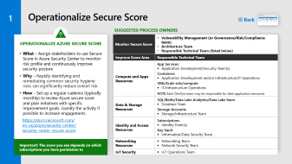
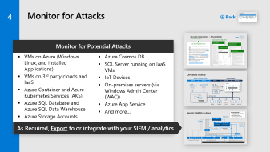
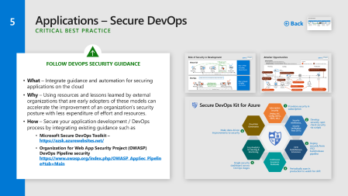
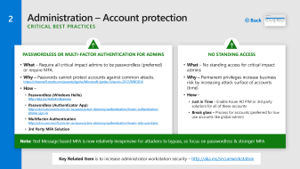
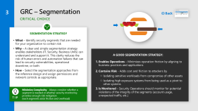

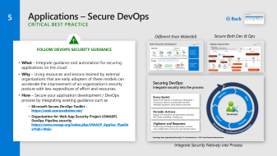
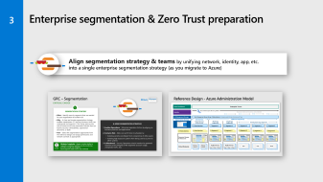
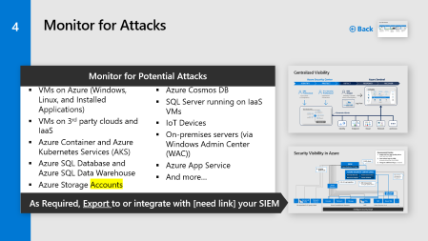
Best Practices 1 - 5
1
2
3
4
5
Operationalize Secure Score for cleaning up risk
Passwordless or MFA for admins
Enterprise segmentation & Zero Trust preparation
Enable Threat Protection for Azure Resources
Follow guidance to secure your DevOps

Slide 12
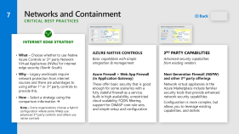
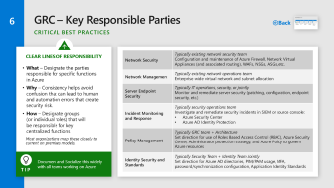
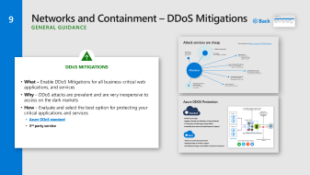
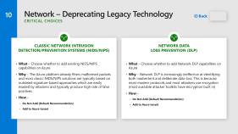

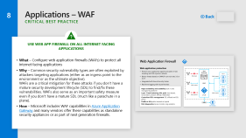

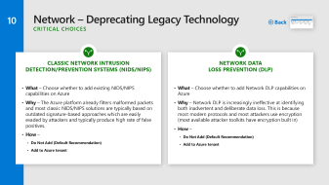
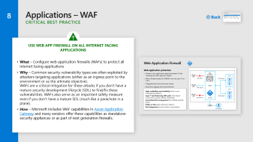
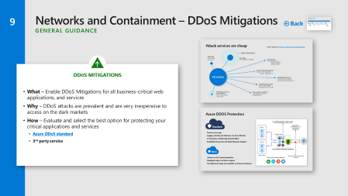
Best Practices 6 - 10
6
7
8
9
10
Assign and Publish Roles/ Responsibilities
Choose Firewall Strategy
Implement Web Application Firewalls
Choose DDoS Mitigation for Critical Apps
Consider Retiring Legacy/Classic Technology

Slide 13

Calls To Action
Follow Best Practices
in your Design → Build → Operations
Learn More
Videos aka.ms/AzureSecurityCompass-Videos
Download slides aka.ms/AzureSecurityCompass
Architecture Guidance aka.ms/AzureSecurityArchitecture
Share
Architecture → architects & technical teams
Slides → all of your teams
Provide Feedback
Compass - Security and Identity Forum in https://aka.ms/SecurityCommunity
Join Secure Score Private Preview https://aka.ms/MicrosoftSecurityPreviewProgram

Slide 14
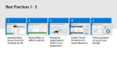
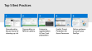
Operationalize Secure Score
1
Back
Suggested Process Owners
Operationalize Azure Secure Score
What – Assign stakeholders to use Secure Score in Azure Security Center to monitor risk profile and continuously improve security posture
Why – Rapidly identifying and remediating common security hygiene risks can significantly reduce overall risk
How – Set up a regular cadence (typically monthly) to review Azure secure score and plan initiatives with specific improvement goals. Gamify the activity if possible to increase engagement.
https://docs.microsoft.com/ en-us/azure/security-center/ security-center-secure-score
Monitor Secure Score | Vulnerability Management (or Governance/Risk/Compliance team) Architecture Team Responsible Technical Team (listed below)
Improve Score Area | Responsible Technical Team
Compute and Apps Resources | App Services Application Development/Security Team(s) Containers Application Development and/or Infrastructure/IT Operations VMs/Scale sets/compute IT/Infrastructure Operations NOTE: Each DevOps team may be responsible for their application resources
Data & Storage Resources | SQL/Redis/Data Lake Analytics/Data Lake Store Database Team Storage Accounts Storage/Infrastructure Team
Identity and Access Resources | Subscriptions Identity Team(s) Key Vault Information/Data Security Team
Networking Resources | Networking Team Network Security Team
IoT Security | IoT Operations Team
Important: The score you see depends on which subscriptions you have permission to

Slide 15
Administration – Account protection Critical Best Practices
2
Back
Passwordless Or Multi-factor Authentication For Admins
What – Require all critical impact admins to be passwordless (preferred) or require MFA.
Why – Passwords cannot protect accounts against common attacks. https://channel9.msdn.com/events/Ignite/Microsoft-Ignite-Orlando-2017/BRK3016
How –
Passwordless (Windows Hello) http://aka.ms/HelloForBusiness
Passwordless (Authenticator App) https://docs.microsoft.com/en-us/azure/active-directory/authentication/howto-authentication-phone-sign-in
Multifactor Authentication https://docs.microsoft.com/en-us/azure/active-directory/authentication/howto-mfa-userstates
3rd Party MFA Solution
No Standing Access
What – No standing access for critical impact admins
Why – Permanent privileges increase business risk by increasing attack surface of accounts (time)
How –
Just in Time - Enable Azure AD PIM or 3rd party solution) for all of these accounts
Break glass – Process for accounts (preferred for low use accounts like global admin)
Note: Text Message based MFA is now relatively inexpensive for attackers to bypass, so focus on passwordless & stronger MFA
Key Related Item is to increase administrator workstation security – http://aka.ms/secureworkstation

Slide 16
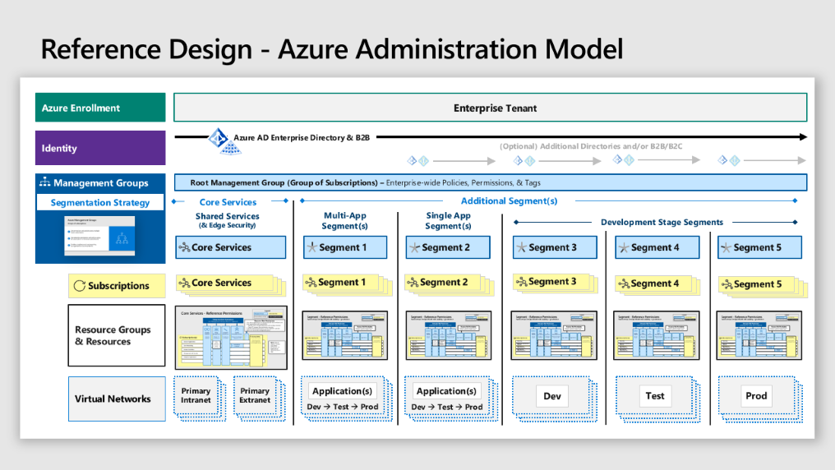
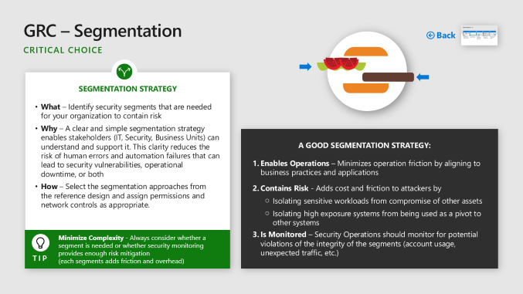
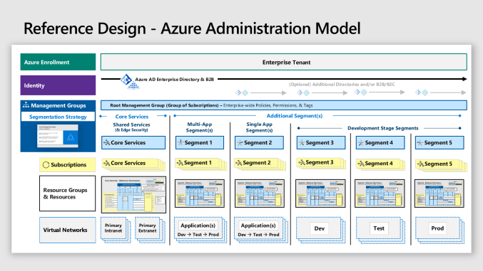
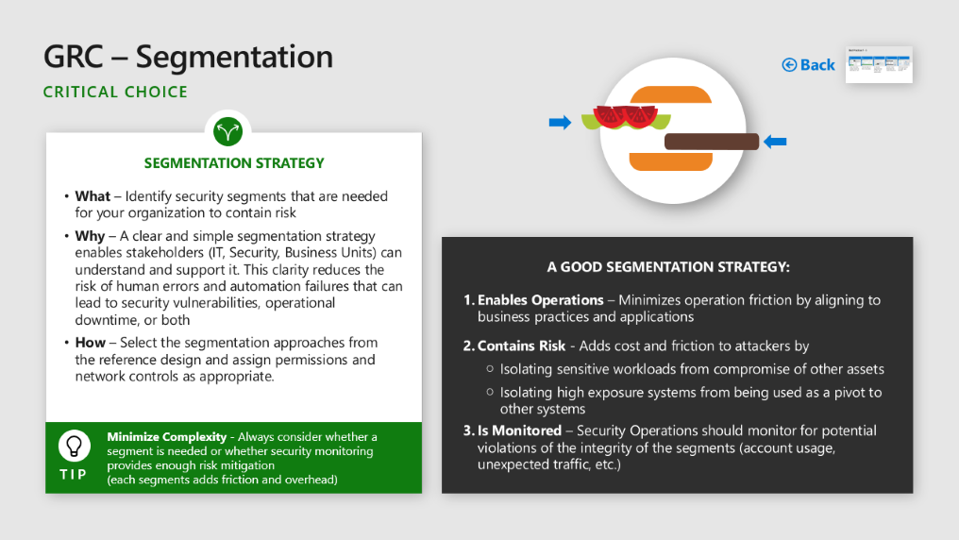
Enterprise segmentation & Zero Trust preparation
3
Align segmentation strategy & teams by unifying network, identity, app, etc. into a single enterprise segmentation strategy (as you migrate to Azure)

Slide 17

GRC – Segmentation
Back
Critical CHOICE
SEGMENTATION STRATEGY
What – Identify security segments that are needed for your organization to contain risk
Why – A clear and simple segmentation strategy enables stakeholders (IT, Security, Business Units) can understand and support it. This clarity reduces the risk of human errors and automation failures that can lead to security vulnerabilities, operational downtime, or both
How – Select the segmentation approaches from the reference design and assign permissions and network controls as appropriate.
A Good Segmentation Strategy:
Enables Operations – Minimizes operation friction by aligning to business practices and applications
Contains Risk - Adds cost and friction to attackers by
Isolating sensitive workloads from compromise of other assets
Isolating high exposure systems from being used as a pivot to other systems
Is Monitored – Security Operations should monitor for potential violations of the integrity of the segments (account usage, unexpected traffic, etc.)
Minimize Complexity - Always consider whether a segment is needed or whether security monitoring provides enough risk mitigation (each segments adds friction and overhead)
Tip

Slide 18



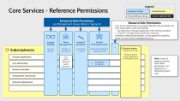
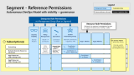
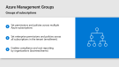




Reference Design - Azure Administration Model
Azure Enrollment
Enterprise Tenant
Identity
Azure AD Enterprise Directory & B2B
(Optional) Additional Directories and/or B2B/B2C
Management Groups
Root Management Group (Group of Subscriptions) – Enterprise-wide Policies, Permissions, & Tags
Segmentation Strategy
Core Services
Additional Segment(s)
Shared Services (& Edge Security)
Multi-App Segment(s)
Single App Segment(s)
Development Stage Segments
Core Services
Segment 1
Segment 2
Segment 3
Segment 4
Segment 5
Subscriptions
Core Services
Segment 1
Segment 2
Segment 3
Segment 4
Segment 5
Resource Groups & Resources
Virtual Networks
Primary
Intranet
Primary Extranet
Dev → Test → Prod
Dev → Test → Prod
Dev → Test → Prod
PaaS Apps
Application(s)
Application(s)
Dev → Test → Prod
Dev
Test
Prod

Slide 19
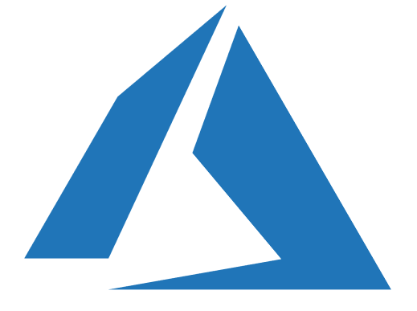




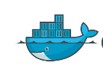

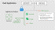







Reference Enterprise Design - Azure Network Security
Hybrid Cloud Infrastructure – Network Architecture
Microsoft Azure
3rd party IaaS
On Premises Datacenter(s)
Core Services
Additional Segment(s)
Shared Services Segment
Segment(s)
Development Stage Segments
Edge Security
Organization
Public IP
Dev
DDoS Mitigation
Extranet Applications
Extranet
Load Balancer (Optional)
Firewall
NSG
NSG
NSG
ExpressRoute Gateway
Gateway subnet
NSG
Test
ExpressRoute
VNET PEERING
Domain Controllers
Management & Security
Legend
Application
NSG
NSG
Subscription
Intranet
Enterprise Applications
Others as needed
Prod
Virtual Network
Subnet
NSG
NSG
NSG
Network Security Group
Hub – Shared Service Virtual Network
Spoke(s) - Aligned to Segment Model

Slide 20

Azure Management Groups
Groups of subscriptions
Set permissions and policies across multiple Azure subscriptions
Set enterprise permissions and policies across all subscriptions in the tenant (enrollment)
Enables compliance and cost reporting by organizations (business/teams)

Slide 21





Core Services - Reference Permissions
Legend
Management Groups
Subscription Roles
Resources/Resource Groups
Custom / Application Roles
Enterprise Role Permissions
via Management Group (Root or Segment)
Resource Role Permissions
Core service applications are typically lift/shift IaaS workloads and most organizations split responsibility
Specialty team manages application with existing console(s)
Central IT manage Azure production resources.
If needed, additional permissions can be assigned to specialty teams via core services management group.
Security Visibility
Security Readers
Policy Management
Reader → Contributor
Central IT Operations
Contributor or Owner
Central Networking Group
Network Contributors + Appliance VMs
…
Subscription(s)
Service Admin (Break Glass Access)
Primarily used for initial configuration and emergency access
Extranet Applications
Policy typically matures over time from audit to enforcement
Note: Scope of diagram includes Azure RBAC permissions, not Application or Operating System roles
Core Networking
Contributor or Owner
Domain Controllers
Management and Security
Enterprise Applications
…

Slide 22
Segment - Reference Permissions Autonomous DevOps Model with visibility + governance
Legend
Management Groups
Subscription Roles
Resources/Resource Groups
Custom / Application Roles
Enterprise Role Permissions
via Management Group (Root or Segment)
Resource Role Permissions
Assigned via segment management group to support Autonomous DevOps model
Security Visibility
Security Readers
Policy Management
Reader → Contributor
IT Operations
Contributor or Owner
Central Networking Group
Network Contributors + Appliance VMs
App1 Admins
App2 Admins
…
Subscription(s)
Service Admin (Break Glass Access)
Primarily used for initial configuration and emergency access
Policy typically matures over time from audit to enforcement
Segment Model Variations
Central IT
Businesss Unit IT
None (app admins only)
Networking
Contributor or Owner
Contributor or Owner (Optional)
Network Security Resources (Optional)
Contributor or Owner
App1 Resources (VMs, Storage, etc.)
Contributor or Owner
App2 Resources (VMs, Storage, etc.)
…

Slide 23


PaaS Application
Dedicated PIP (Modern Architecture)
Edge Security
(Classic Architecture)
OR
NSG
Other Services
AppService Subnet
Some services cannot be deployed to virtual networks
Other Public Cloud Providers
Azure Services not yet enabled for Service Endpoints (Service Tunnel) or VNet Service Injections
Key Vault
Service Endpoints or VNet injection
Storage
App Service
Others

Slide 24
IaaS Application
Dedicated PIP (Modern Architecture)
Edge Security
(Classic Architecture)
OR
NSG
N-tier subnet
Key Vault
SQL1
Service Endpoints or VNet injection
Storage
Other servers
Web servers
SQL2
Others

Slide 25







Monitor for Attacks
4
Back
Monitor for Potential Attacks
VMs on Azure (Windows, Linux, and Installed Applications)
VMs on 3rd party clouds and IaaS
Azure Container and Azure Kubernetes Services (AKS)
Azure SQL Database and Azure SQL Data Warehouse
Azure Storage Accounts
Azure Cosmos DB
SQL Server running on IaaS VMs
IoT Devices
On-premises servers (via Windows Admin Center (WAC))
Azure App Service
And more…
As Required, Export to or integrate with your SIEM / analytics

Slide 26




Security Operations – Azure Alerts Critical GUIDANCE
Back
Azure Security Center Alerts
ASC BUILT IN Security Alerts
What – Enable Azure Security Center security Alerts
Why – Azure Security Center provides actionable detections for common attack methods (Alert List depicted on this slide), which can save your team significant effort on query development.
These alerts are focused on high true positive rate by leveraging Microsoft’s extensive threat intelligence, advanced machine learning, industry leading Endpoint Detection & Response (EDR) (MITRE report), and other approaches.
How – Enable Azure Security Center (Recommend Standard Tier) https://docs.microsoft.com/en-us/azure/security-center/security-center-get-started
Virtual Machine Behavioral Analysis (VMBA)
SQL Database & Data Warehouse Analysis​
Contextual Information
Network Analysis

Slide 27
















Centralized Visibility
Azure Security Center
Azure Sentinel
IDENTIFY
RESPOND
RECOVER
DETECT
PROTECT
GRC Professional
IT / Security Professional
SOC Analyst
Assess Risk & Compliance
Implement Protections
Primary Console
Alerts, Investigation
Log Flow
Generate Alerts
Identity
Endpoint
Cloud
Network
and more

Slide 28
Security Visibility in Azure
Recommended Priorities
Enable ASC for high quality alerts (and feed into SIEM)
Feed critical logs to SIEM (store/archive them if no SIEM)
Integrate additional logs as needed
1. ASC alerts
SIEM
Azure Sentinel or 3rd Party
0. Existing
SIEM feeds
AZURE SECURITY CENTER (ASC)
Anomaly Detection
Fusion across sources
ASC Threat Intelligence Integration
Behavioral Analytics
Partner Solutions
2. & 3. Log ingestion
1. ASC integrations for high quality alerts
Azure Monitor
SQL Threat Detection
…
Servers & VMs
Network Devices
Console
Network
Storage
VMs
ASE
Azure SQL
…
On-premises & 3rd party cloud
Azure foundational elements
IaaS
Azure Services (PaaS)
Intelligent Security Graph

Slide 29

Azure Security Center Advanced Threat Detection (& Governance) for Azure Workloads
Anomaly detection
Uses statistical profiling to build historical baselines
Alerts on deviations that conform to a potential attack vector
Threat intelligence
Looks for known malicious actors using Microsoft global threat intelligence
Behavioral analytics
Looks for known patterns and malicious behaviors
Partners
Integrates alerts from partner solutions, like firewall and antimalware
Fusion
Combines events and alerts from across the kill chain to map the attack timeline
Security Information and Event Management (SIEM)
Azure Sentinel or Legacy

Slide 30












Core capabilities
Cloud Native SIEM + SOAR - Azure Sentinel
AZURE SENTINEL
Analyze & detect threats
Investigate & hunt suspicious activities
Automate & orchestrate response
Collect
Integrate
Microsoft Services
Machine learning, UEBA
Interactive Attack Visualization, Azure Notebooks
Playbooks
ServiceNow
Apps, users, infrastructure
Enrichment with Intelligence (Geo location, IP Reputation)
Public Clouds
Other tools
Data Ingestion
Data Repository
Data Search
Community
Security solutions
Azure Monitor (log analytics)

Slide 31






Applications – Secure DevOps Critical Best Practice
5
Back
Different than Waterfall
Secure Both Dev & Ops
Follow DevOps security guidance
What – Integrate guidance and automation for securing applications on the cloud
Why – Using resources and lessons learned by external organizations that are early adopters of these models can accelerate the improvement of an organization’s security posture with less expenditure of effort and resources.
How – Secure your application development / DevOps process by integrating existing guidance such as
Microsoft Secure DevOps Toolkit – https://azsk.azurewebsites.net/
Organization for Web App Security Project (OWASP) DevOps Pipeline security https://www.owasp.org/index.php/OWASP_AppSec_Pipeline#tab=Main
Integrate Security Natively into Process

Slide 32




Attacker Opportunities
Back
Attacker Pivot Risks
Secondary attacks using compromised artifacts/access
Lateral Movement – Pass the hash/ticket/password/etc.
Development Artifacts – Stolen keys/credentials, implanted malware or backdoors, etc.
Legend
Developer-based attacks
IT and Operations-based attacks
Planning
Coding
Testing
Production
Production App Vulnerability
Vuln Discovered in App or a Re-used Component
Public
repository
Coding Vulnerability Introduce exploitable vulns
Supply Chain Vuln/Implant
Vulnerable Code added to Application
Writing New Code
Design Vulnerability
Design Choices create Security Issues
Re-use components
Web/Email Risk
On Dev workstation
Corporate
repository
Build automation
Version
release
Upload to Repository
Development Infrastructure
Infrastructure Security Risks
Repository Access
Weak Authentication/Authorization
Tester Workstation
Developer team
Application code
Developer Workstation
Production Infra Vulnerability
Vulnerability in infrastructure hosting App (on-prem, Azure, AWS, etc.)
Credential Attacks
Weak passwords/authentication
Dev Workstation Security
Infrastructure Security Risks

Slide 33



Role of Security in Development
Back
Bias to Plan
& Quality
(Weeks/Months)
Waterfall
Full lifecycle security ideal but rare
Planning
Coding
Testing
Typically security is a quality gate in release
Production
Feedback Loop
Bias to Speed & Agility
(Hours/Days)
DevOps
Quality and Security risk mitigated by rapidly release of fixes
Embedding security expertise and dynamic + static testing in process required for success
Planning / Coding
Testing / Production
Feedback Loop

Slide 34
Securing DevOps: Integrate security into the process
Governance – Continuous Improvement
Operate
Every Sprint Reduce risk natively in Continuous Integration / Continuous Delivery (CI/CD) with real-time developer guidance, build checks, and more
Plan
Deliver
Develop
Periodic Actions Regular risk reduction and governance activities like Threat modelling, Training, etc.
Developer
Vigilance and Response Monitoring and Response processes to ensure close collaboration of Security and DevOps teams
Learnings from migrating Microsoft’s IT environment to ~95% cloud-based infrastructure

Slide 35


GRC – Key Responsible Parties
6
Back
Critical Best Practices
Clear Lines of Responsibility
What – Designate the parties responsible for specific functions in Azure
Why – Consistency helps avoid confusion that can lead to human and automation errors that create security risk.
How – Designate groups (or individual roles) that will be responsible for key centralized functions
Most organizations map these closely to current on premises models.
Network Security | Typically existing network security team Configuration and maintenance of Azure Firewall, Network Virtual Appliances (and associated routing), WAFs, NSGs, ASGs, etc.
Network Management | Typically existing network operations team Enterprise-wide virtual network and subnet allocation
Server Endpoint Security | Typically IT operations, security, or jointly Monitor and remediate server security (patching, configuration, endpoint security, etc.)
Incident Monitoring and Response | Typically security operations team Investigate and remediate security incidents in SIEM or source console: Azure Security Center Azure AD Identity Protection
Policy Management | Typically GRC team + Architecture Set direction for use of Roles Based Access Control (RBAC), Azure Security Center, Administrator protection strategy, and Azure Policy to govern Azure resources
Identity Security and Standards | Typically Security Team + Identity Team Jointly Set direction for Azure AD directories, PIM/PAM usage, MFA, password/synchronization configuration, Application Identity Standards
Document and Socialize this widely with all teams working on Azure
Tip

Slide 36




Networks and Containment Critical Best Practices
7
Back
Internet EDGE STRATEGY
What – Choose whether to use Native Azure Controls or 3rd party Network Virtual Appliances (NVAs) for internet edge security (North-South)
Why – Legacy workloads require network protection from internet sources and there are advantages to using either 1st or 3rd party controls to provide this.
How – Select a strategy using the comparison information →
Note – Some organizations choose a hybrid configuration where some VNets use advanced 3rd party controls and others use native controls
AZURE NATIVE CONTROLS
Basic capabilities with simple integration & management
Azure Firewall + Web App Firewall (in Application Gateway)
These offer basic security that is good enough for some scenarios with a fully stateful firewall as a service, built-in high availability, unrestricted cloud scalability, FQDN filtering, support for OWASP core rule sets, and simple setup and configuration
3rd Party Capabilities
Advanced security capabilities from existing vendors
Next Generation Firewall (NGFW) and other 3rd party offerings
Network virtual appliances in the Azure Marketplace include familiar security tools that provide enhanced network security capabilities
Configuration is more complex, but allows you to leverage existing capabilities, and skillets

Slide 37







Reference Configuration with Native Controls
Azure Firewall + Application Gateway with Web App Firewall (WAF)
Core Services
Core Services Subscription
Azure Firewall
Public IP
1
2
Firewall Subnet
Virtual Network
Internet
NSG
DDoS Protection
Subnet
Public IP
Web Application Firewall
NSG
Gateway Subnet
On Premises Network(s)
ExpressRoute Gateway
ExpressRoute
Network Security Group (NSG)
NSG
NSG
Subnet
Subnet
6

Slide 38


Azure Firewall
Cloud native stateful Firewall as a service
L3-L7 Connectivity Policies
A first among public cloud providers
Spoke 1
Microsoft Threat Intelligence Known malicious IPS and FQDNs
Central governance of all traffic flows
Built-in high availability and auto scale
Network and application traffic filtering
Centralized policy across VNets and subscriptions
Complete VNET protection
Filter Outbound, Inbound, Spoke-Spoke & Hybrid Connections traffic (VPN and ExpressRoute)
Threat intelligence-based filtering to alert/deny traffic from/to known malicious IP addresses and domains.
Centralized logging
Archive logs to a storage account, stream events to your Event Hub, or send them to Log Analytics or Security Integration and Event Management (SIEM) system of choice
NAT, Network and Application traffic filtering rules allows Inbound/Outbound access
Central VNet
Spoke2
Azure Firewall
Spoke VNets
Azure to On-Prem traffic filtering
Traffic is denied by default
On-Premises
https://docs.microsoft.com/en-us/azure/firewall/

Slide 39

Web Application Firewall
Web application protection
Protects your application against prevalent X-Site Scripting and SQL Injection attacks
Blocks threats based on OWASP core rule sets 3.0 or 2.2.9
Integrated with Azure Security Center
Real-time logging with Azure Monitor
App Gateway
Site 1
XSS attack
Valid request
WAF
Valid request
Site 2
High availability and scalability built in and managed by platform
Layer 7 load balancing URL path, host based, round robin, session affinity, redirection
Centralized SSL management SSL offload and SSL policy
Public or ILB public internal or hybrid
Rich diagnostics Azure monitor, Log analytics
Valid request
SQL injection
L7 LB
VPN
On-Premises

Slide 40





Reference Configuration with Virtual Appliance(s)
Next Generation Firewall with Integrated WAF/Proxy
Core Services
Core Services Subscription
Popular Next Generation Firewalls available in Azure Marketplace
Load balancer enables scalability and availability
DDoS Protection Standard can be applied to public IP addresses.
More Information online
https://docs.microsoft.com/en-us/azure/architecture/reference-architectures/hybrid-networking/shared-services
1
2
Public IP
Virtual Network
Internet
DMZ outside
N I C
NVA
N I C
DMZ inside
NSG
Subnet
DDoS Protection
Availability set
Load balancer
N I C
NVA
N I C
NSG
NSG
NSG
Gateway Subnet
On Premises Network(s)
ExpressRoute Gateway
ExpressRoute
Network Security Group (NSG)
NSG
NSG
Subnet
Subnet
6

Slide 41


Applications – WAF Critical BEST PRACTICE
8
Back
Use Web App Firewall on All Internet Facing Applications
What – Configure web application firewalls (WAFs) to protect all internet facing applications
Why – Common security vulnerability types are often exploited by attackers targeting applications (either as an ingress point to the environment or as the ultimate objective). WAFs are a critical mitigation for these attacks if you don’t have a mature security development lifecycle (SDL) to find/fix these vulnerabilities. WAFs also serve as an important safety measure even if you don’t have a mature SDL (much like a parachute in a plane).
How – Microsoft includes WAF capabilities in Azure Application Gateway and many vendors offer these capabilities as standalone security appliances or as part of next generation firewalls.

Slide 42




Networks and Containment – DDoS Mitigations General Guidance
9
Back
DDoS Mitigations
What – Enable DDoS Mitigations for all business-critical web applications, and services
Why – DDoS attacks are prevalent and are very inexpensive to access on the dark markets
How – Evaluate and select the best option for protecting your critical applications and services
Azure DDoS standard
3rd party service

Slide 43







Azure DDOS Protection
L3-L4 DDoS mitigation policies tuned to your application’s traffic profile
Standard
Spoke 1
Application performance and availability is guaranteed
Tuned to your apps
Logging, alerting and telemetry via Azure Monitor
L7 Protection via Web App Firewall (WAF)
Availability Guarantee and Rapid Response Support
Central VNet
Spoke2
Basic
Azure DDoS Protection Standard
Always on L3/L4 attack protection
Deployed today in all Azure regions
No additional charge and available to all Azure Customers
Spoke VNets
Blocks malicious traffic from internet

Slide 44
Network – Deprecating Legacy Technology Critical CHOICES
10
Back
Classic Network Intrusion Detection/Prevention Systems (NIDS/NIPS)
What – Choose whether to add existing NIDS/NIPS capabilities on Azure
Why – The Azure platform already filters malformed packets and most classic NIDS/NIPS solutions are typically based on outdated signature-based approaches which are easily evaded by attackers and typically produce high rate of false positives.
How –
Do Not Add (Default Recommendation)
Add to Azure tenant
Network Data Loss Prevention (DLP)
What – Choose whether to add Network DLP capabilities on Azure
Why – Network DLP is increasingly ineffective at identifying both inadvertent and deliberate data loss. This is because most modern protocols and most attackers use encryption (most available attacker toolkits have encryption built in)
How –
Do Not Add (Default Recommendation)
Add to Azure tenant

Slide 45
Thank you!

